Slide 1


HR COMPENSATION

Slide 2

Who Gets To Receive Commissions?
Account Executive I
QUOTA?
Account Executive II
QUOTA?
Account Executive III
QUOTA?

Slide 3

Where’s the Quota Cap?
Account Executive I
Account Executive II
Account Executive III
$500,000
$600,000
$750,000

Slide 4

Name of the Game, Close Deals !
Those were big numbers huh?
Let’s see how hard work pays off

Slide 5
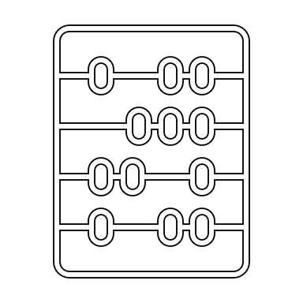

Show Me the Money !
Title | Base Minimum | Base Maximum | 0-100% | 100-125% | 125-150% | 150-200% | >200%
Account Executive I | $ 30,000 | $ 65,000 | 10% | 15% | 18% | 22% | 10%
Account Executive II | $ 50,000 | $ 80,000 | 13% | 17% | 21% | 26% | 13%
Account Executive III | $ 75,000 | $ 125,000 | 15% | 19% | 23% | 30% | 15%
These are the bare bones here.

Slide 6

Let’s Take a Look
Bertie Turpey
Account Executive III

Slide 7

Let’s Look Deeper
Account Executive III
Benchmark Base Salary/ $85,000
Benchmark Commission/ $125,000
Account Executive II
Benchmark Base Salary/ $65,000
Benchmark Total Pay/ $160,000
Account Executive I
Benchmark Base Salary/ $50,000
Benchmark Total pay/ $210,000
Benchmark Commission/ $75,000
Benchmark Total Pay/ $125,000
Benchmark Commission/ $95,000

Slide 8

Compensation Conclusion
Close lots of deals, make more commission
Keep your quota in mind

